Slide 1
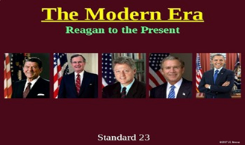
SSUSH23- ASSESS THE POLITICAL, ECONOMIC, AND TECHNOLOGICAL CHANGES – DURING THE Reagan, Bush Sr., Clinton, Bush, and Obama administrations

Slide 2
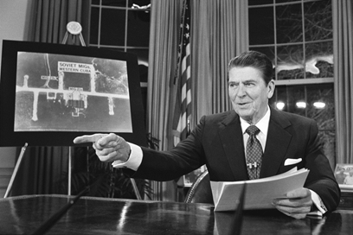
President Ronald Reagan

Slide 3
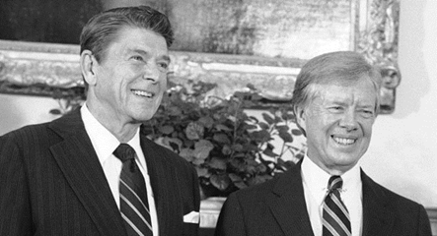
Reagan/Carter
Reagan ran against President Jimmy Carter
Carter’s failed Iran Hostage attempt made him appear ineffective and as a result, lost to Reagan
Reagan pledged to restore the US’s economy and prestige at home.

Slide 4
Challenges of the Modern President’s
Reagan
Reagan
Began with the continuation of the Cold War division between the US and the Soviet Union
The USSR built up it’s military arsenal in the late 70’s and 80’s, but the US still maintained an edge
Reagan began modernizing US forces and thought about the creation of “Star Wars”
The Soviets could not keep up w/ this technology bc the SDI (Strategic Defense Imitative was too costly)
The USSR’s economy was in decline bc of yrs of agricultural & industrial failure.
Reagan put more pressure on the USSR’s economy by negotiating w/ the Arabs to lower their oil prices- causing the Soviets to lower their oil prices just to be competitive.
Oil was the Soviets main source of revenue (income)- oil exports
These actions caused the Soviet President- Gorbachev to begin a policy of economic rebuilding (Perestroika) and political reform (Glasnost).

Slide 5
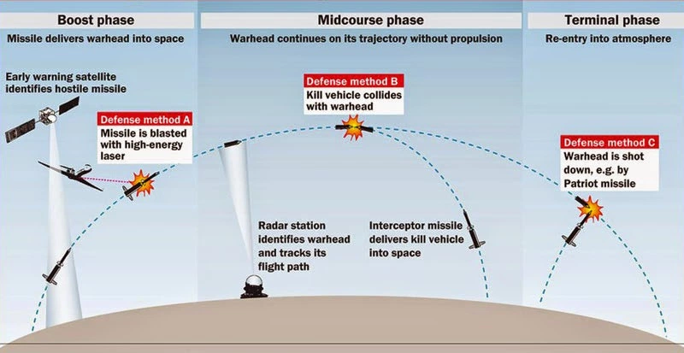
President Reagan’s Anti-ballistic missile shield- The Strategic Defense Initiative (SDI) or Star Wars

Slide 6
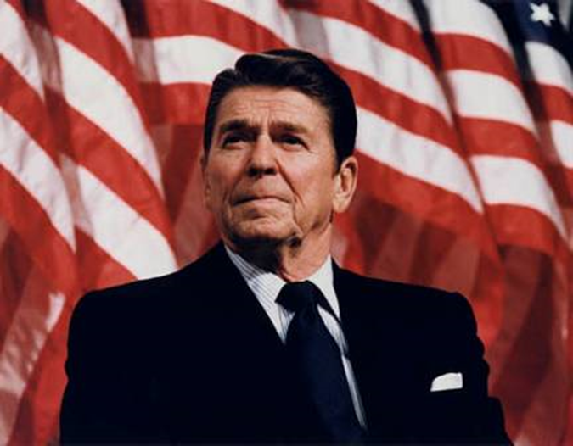
Winning the Cold War
Reagan took a strong stance against communism and the Soviet Union.
Reagan viewed the USSR as the “focus of evil in the modern world” and as a threat to U.S. security

Slide 7
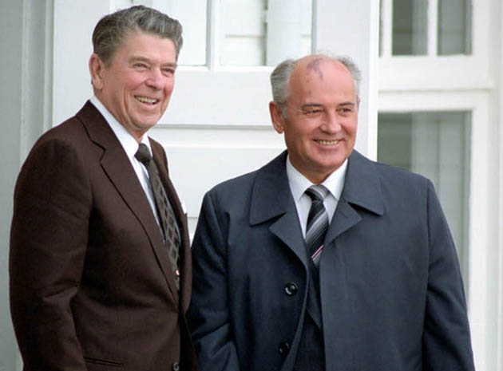
Reagan
Gorbachev’s New Policies-
Allowed free speech
Allowed free press and other reforms
These changes put the USSR on the path to a democratic government
This opened up dialogue between Reagan and Gorbachev
This resulted in a Nuclear Arms Agreement between the US and the Soviet Union
Gorbachev’s reforms led to the collapse of the Soviet Union due the Kremlin’s control of surrounding states that made up the Soviet Union
The Eastern European states that were once under control rebelled and gained their independence for the 1st time since WWII
By 1989 the COLD WAR was over!
June 12, 1987, in Berlin, Reagan asked Gorbachev to tear down the wall separating East and West Berlin, Germany

Slide 8
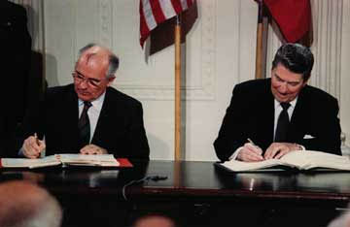
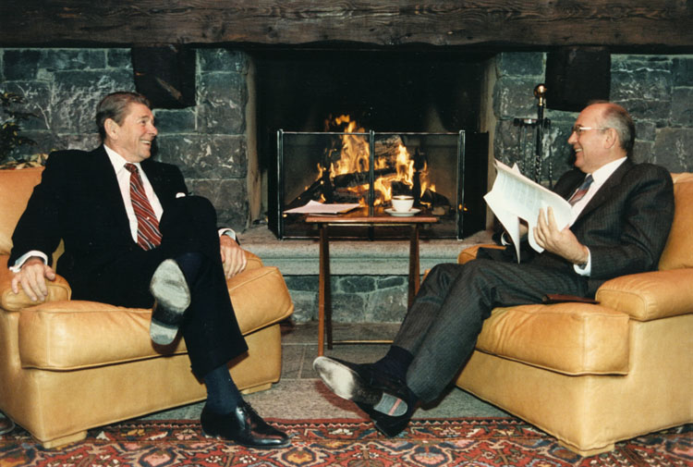
In 1987, Reagan & Gorbachev signed the
INF Treaty eliminating ICBMs in Europe

Slide 9
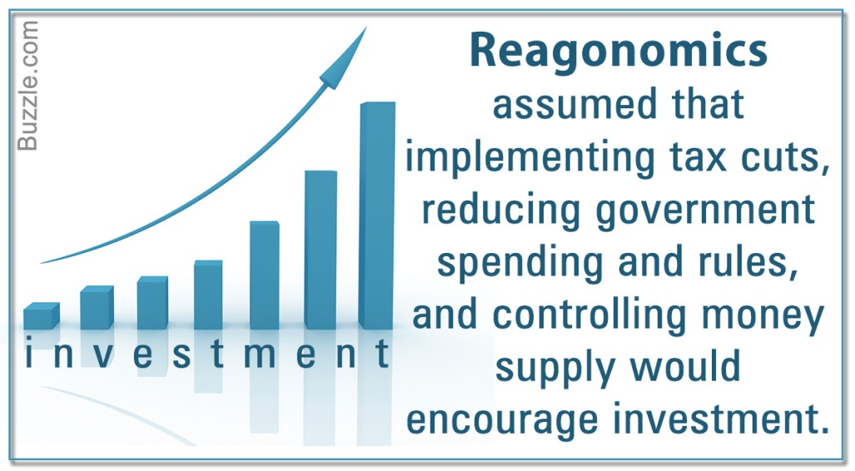
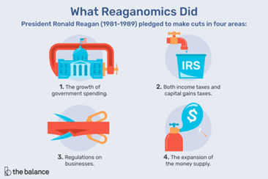
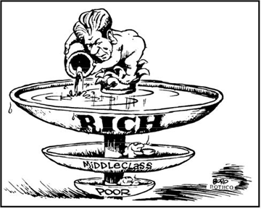
Reagan’s Economic Policy of Reaganomics
In the 70’s the US’s economy was stagnant (no growth).
The economy grew under Reaganomics but this caused a huge deficit.
Reaganomics emphasized the “Trickle Down Theory”

Slide 10
Reaganomics
Reagan believed that if Americans had more money to spend, then the economy would improve.
4 Key components-
1. reduce government spending
2. Reduce income tax and capital gains tax (taxes placed on the sale of property or investments)
3. Reduce government regulation
4. Control the money supply to reduce inflation
Growth occurred but this led to economic problems in the 1990’s.

Slide 11
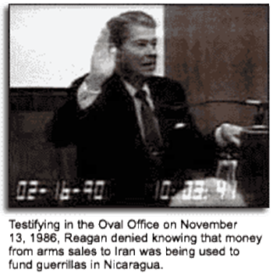
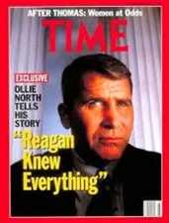
Reagan and the Iran Contra-Scandal
The Iran Contra Affair was a scandal during the Reagan administration that senior administrators provided weaponry to Iran, who was an enemy of the United States and under an arms embargo, as well as using funds from that operation to supply Nicaraguan Contras weapons to rebel against the Sandinista regime. Going against Congress legislation as well as the official policies of the Reagan administration, negotiations with Iran began. These arms were given in hopes that it would secure the release of American hostages that were being held by Hezbollah terrorists who followed Iran’s leader, Ayatollah Khomeini.
(General Oliver North, right, took the fall)

Slide 12
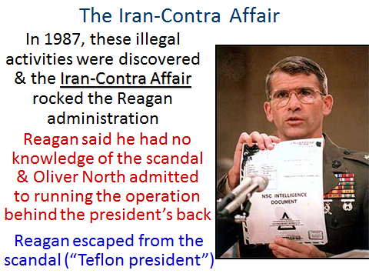
Scandal

Slide 13
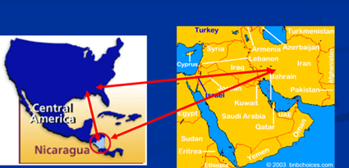
Iran Contra Scandal- Reagan’s 2nd Term

Slide 14
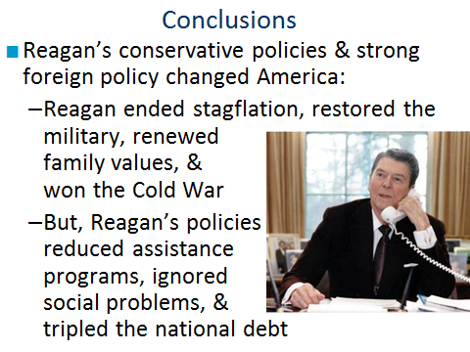

Slide 15
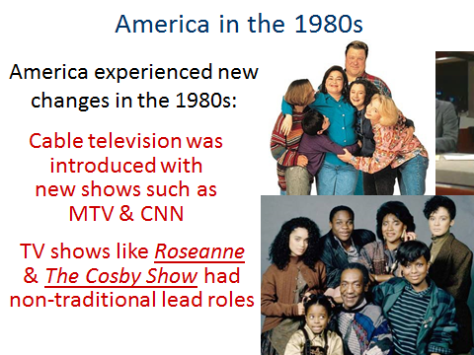

Slide 16
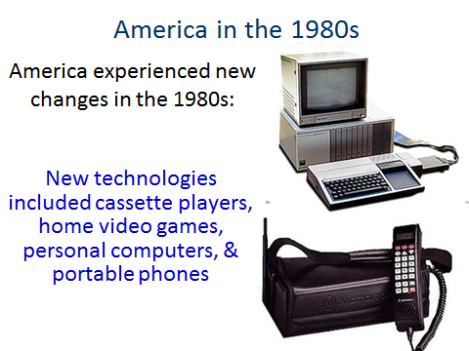

Slide 17
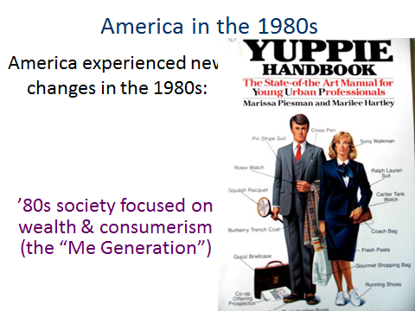

Slide 18
21st Century Technology
Instant Information
Social Media
Changes-
Social Media is the new technological phenomenon where individuals share information on online communities like-
Facebook, Twitter, Instagram and Snapchat
Problems-
Credibility of information
Cyber bullying
Businesses and individuals rely heavily on computers, the internet and social media for communication and productivity
Problems-
Trustworthiness of information
Cyber security risks

Slide 19
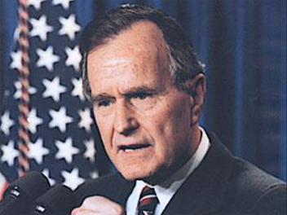
George H. W. Bush- America by 1992
Republican control of the presidency continued after Reagan under George H. W. Bush.
After defeating Iraq in the Persian Gulf War in 1991, Bush’s popularity was high.
Large gov’t deficits due to years of tax cuts & increased military spending led to a recession in 1992.
Bush raised taxes in order to decrease deficit spending, after promising “no new taxes”

Slide 20
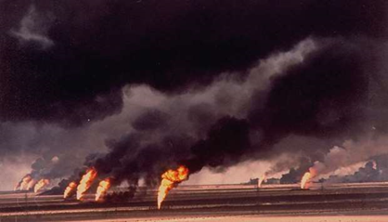
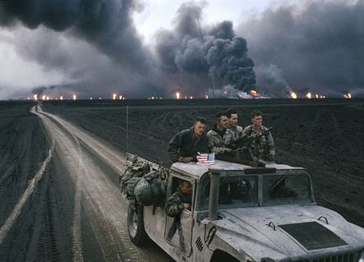
George H. W. Bush
Iraqi leader Saddam Hussein ordered the invasion and occupation of neighboring Kuwait in early August 1990.
Alarmed by these actions, fellow Arab powers such as Saudi Arabia and Egypt called on the United States and other Western nations to intervene.
Hussein defied United Nations Security Council demands to withdraw from Kuwait by mid-January 1991, and the Persian Gulf War began with a massive U.S.-led air offensive known as Operation Desert Storm.
After 42 days of relentless attacks by the allied coalition in the air and on the ground, U.S. President George H.W. Bush declared a cease-fire on February 28; by that time, most Iraqi forces in Kuwait had either surrendered or fled.

Slide 21
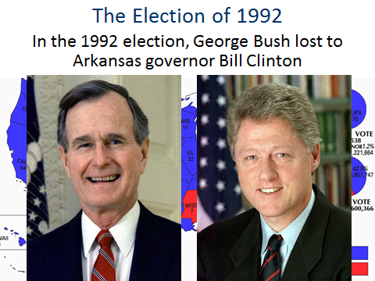
President Bill Clinton

Slide 22
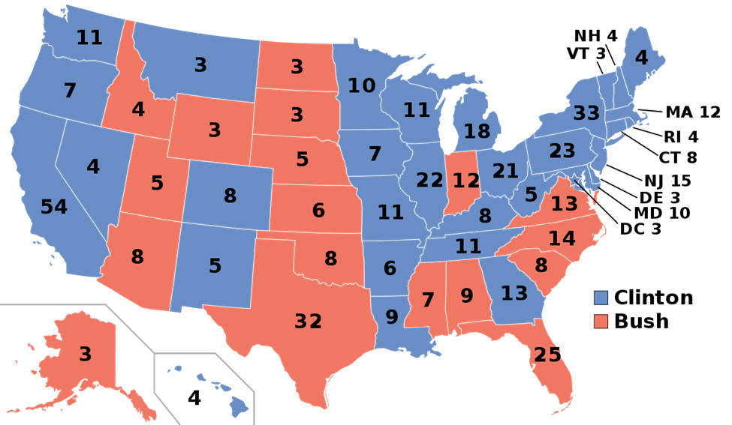
The Election of 1992- George H.W. Bush lost to Bill Clinton (Governor of Arkansas)

Slide 23
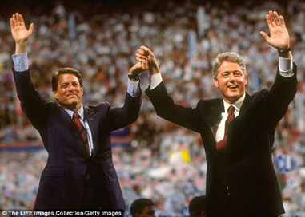
President Clinton and Vice President Al Gore

Slide 24

The Presidency of Bill Clinton
Clinton defined himself a “new Democrat” by embracing both liberal & conservative policies
Watch this Clinton/Gore campaign ad from 1992.
In what ways is Clinton selling himself as a “different kind” of Democrat?

